Slide 1
SF Admin Basics Challenge - I
What you need
Trailhead playground
Challenge
UC #1: Enable login as option policy to proxy user from setup
UC #2 : Clone “Standard platform User” profile and give a name “Custom:Standard platform user – Partner Operations”
UC #3 : Clone “Standard platform User” profile and give a name “Custom:Standard platform user – Sales Manager”
UC #4 : Create 2 new users
User 1 name -“Roger Willson”
User 2 name -“Daniel Crook”
profile: “Custom:Standard platform user - Sales Manager”
License: Salesforce Platform
UC #5 : Create a new user
name -“Jennie Romanoff”
profile: “Custom:Standard platform user - Partner Operations”
License: Salesforce Platform

Slide 2
SF Admin Basics Challenge - I
UC #6 : Create a new app named “Hotel Review & Analysis”. Ensure the following navigation links are present in the app
Account, Contact & Report
UC #7 : Ensure “Hotel Review & Analysis” app is accessible only by users having profile: “Custom:Standard platform user - Partner Operations”

Slide 3
SF Admin Basics Challenge - II
What you need
Trailhead playground
Challenge
UC #1 : Clone “Standard platform User” profile and give a name “Custom:Standard platform – Sales Team Member”
UC #2 : Create 2 new users
User 1 name -“Duke Detain”
User 2 name -“Mike Harly”
profile: “Custom:Standard platform - Sales Team Member”
License: Salesforce Platform
UC #3: Create a custom object named “Hotel Reviews” with the below fields
Reviewer (Type: should have relationship with Contact object)
Hotel (Type: should have relationship with Account object)
Rating (Type: picklist with values 1,2,3,4,5)
Review Comments (Type: Text Area)
UC #4: Create a custom tab for “Hotel Reviews” and include the same in “Hotel Review & Analysis” app

Slide 4
SF Admin Basics Challenge - II
UC #5: Ensure “Hotel Reviews” tab is visible for users having the below profile
Custom:Standard platform user – Partner Operations
Custom:Standard platform user – Sales Manager
Custom:Standard platform – Sales Team Member
UC #6: Create below custom fields on “Account” object
Is Partner Hotel (Type: Checkbox)
New Partner Enrollment Commission % (Type: Number)
Partner Primary Relationship Manager (Type: Should have relationship with user object)
Hotel Latitude (Type: Number)
Hotel Longitude(Type: Number)
UC #7: Ensure custom field “New Partner Enrollment Commission %” on account is mandatory ONLY users having profile “Custom:Standard platform user – Partner Operations”
UC #8: Ensure custom field “New Partner Enrollment Commission %” on account is READ ONLY users having profile “Custom:Standard platform user – Sales Manager” / “Custom:Standard platform – Sales Team Member”

Slide 5
SF Admin Basics Challenge - II
UC #9: Modify account layout and keep only the below fields
Account name, Parent Account, Type, phone, website, billing address, shipping address, Is Partner Hotel,
Introduce a new section named “Partner details” for the below fields
New Partner Enrollment Commission % , Partner Primary Relationship Manager
Hotel Latitude, Hotel Longitude
UC #10: Create a new account “List View” named “Partner Hotels” to show accounts having “Is Partner Hotel” value true
UC #11: Update Account highlights panel to show ONLY
- Type, Phone, Website, Account Owner, Is Partner Hotel, Partner Primary Relationship Manager
Link to upload screen shots
https://forms.office.com/r/jSMrxqeLa9

Slide 6
SF Admin Basics Challenge - III
What you need
Trailhead playground
Challenge
UC #1 : Use any one of the Data load options in SF and upload “AccountsAndContacts – Distinct.csv”
UC #2 : Use any one of the Data load options in SF and upload “Hotel Reviews.csv”
UC #3: Create the following custom fields on “Lead” object
Is Partner Hotel (Type: Checkbox)
Hotel Category (Type: Picklist | Values : 2 star, 3 star, 4 star, 5 star, 7 star)
UC #4: Use Data loader options in SF and upload “New Leads.csv”
UC #5: From the lead data uploaded in above step, select the following leads from UI and convert into account, contact and opportunity
Lead #1: Noah Wilson
Lead #2: Ethan Roberts

Slide 7
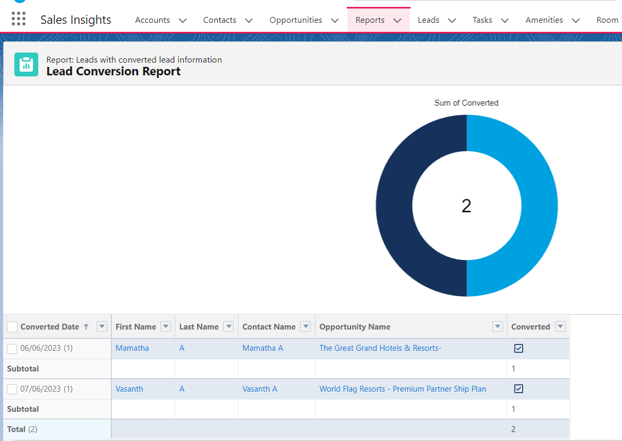
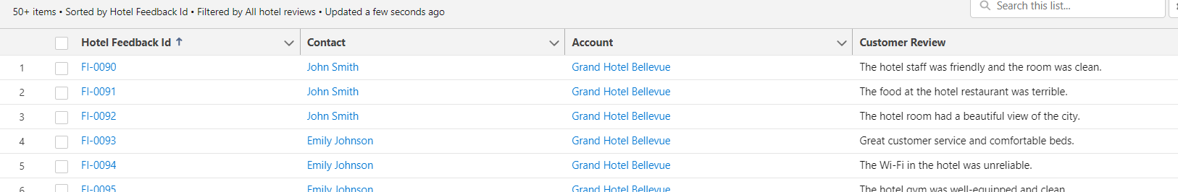
SF Admin Basics Challenge - III
UC #6: Create a new report to list all the converted leads. Ensure the report shows leads converted in UC #5. Report should show columns as given in screen shot
UC #7: Create a new account “List View” named “Hotel Reviews” to show the following columns
- Account(Hotel) name
- Contact (Traveler) name
- Review comments

Slide 8
SF Admin Basics Challenge - III
UC #8: Create a validation rule to ensure account Billing country is not blank when Is Partner Hotel flag is true
Link to upload screen shots
To be shared

Slide 9
SF Admin Basics Challenge - 4
What you need
Trailhead playground
Challenge
UC #1 : Enable Multi Currency in your playground org
UC #2 : Ensure your org. supports
- USD as corporate currency
- INR, GBP, EUR as local currencies
UC #3: Have exchange rates configured for each local currency
UC #4 : Create a new user
User name -“Tom Wheelie”
profile: Clone “Custom:Sales Profile” and name it as ‘TH: Custom – Sales Profile’
License: Salesforce
Currency: EUR

Slide 10
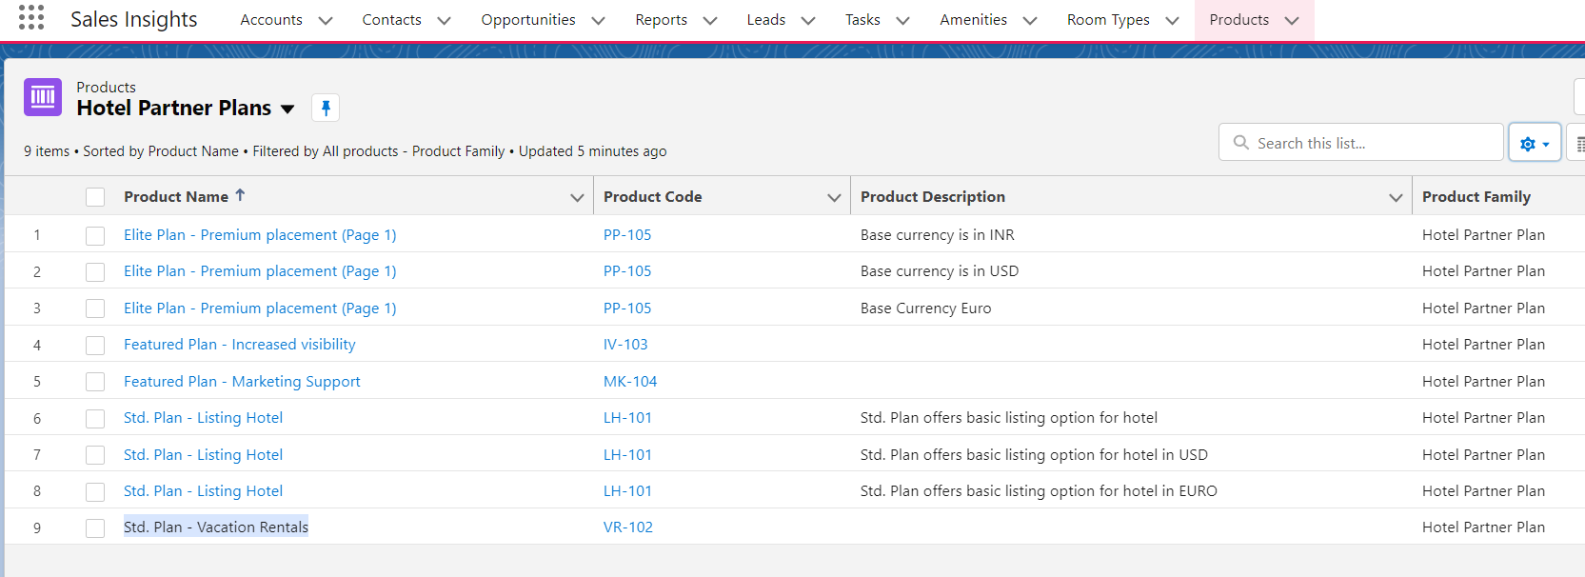
SF Admin Basics Challenge - 4
UC #4 : Set up products and price books as below
- Should have 3 price books (Standard (USD), INR & EURO)
- Should have 4 products
- Elite Plan - Premium placement | Product Family: Hotel Partner Plan
- Featured Plan - Increased visibility | Product Family: Hotel Partner Plan
- Std. Plan - Listing Hotel | Product Family: Hotel Partner Plan
- Std. Plan - Vacation Rentals | Product Family: Hotel Partner Plan
- Ensure each product is added to all the 3 price books and set unit price based on price book currency
UC #5: Create a new list view on Product with the below columns

Slide 11
SF Admin Basics Challenge - 4
UC #6 : Create an opportunity named “Turbo - 6 months subscription plan” for the account “Cityscape Hotel”.
Ensure Opp. Record currency is set as ‘USD’. Add the below 2 products
- - Featured Plan - Increased visibility | Quantity - 2
- Std. Plan - Listing Hotel | Quantity - 1
UC #7: Create a new marketing user
User name -“Daisy Kaboom”
Profile: Clone “Custom: Marketing Profile” and name it as ‘TH: Custom – Marketing Profile’
License: Salesforce
UC #8: Create a new campaign named ‘Monthly News Letter’ with start date as July 01, 2023 and end date as ‘Dec 31, 2023’
UC #9: Introduce a custom picklist field named ‘Contact Type’ on contact object to differentiate ‘Business’ vs ‘Travellers’. Ensure the below contacts are updated as ‘Travellers Contact’
- John Smith
- Liam Thompson
- Amara Silva
UC #10: Create a report on contact object and filter only the travellers contacts. From report, add all traveller contacts to the campaign “Monthly News-Letter”

Slide 12
SF Admin Basics Challenge - 4
Link to upload screen shots
To be shared

Slide 13
SF Admin Basics Challenge - 5
What you need
Trailhead playground
Challenge
UC #1 : Create new users as below
User 1 name -“Daise Kaboom”
User 2 name -“Sinclair Roman”
profile: “Custom:Standard platform user – Partner Operations”
License: Salesforce Platform
User 3 name -“Tracy Whitney”
profile: “TH: Custom - Executives”
License: Salesforce

Slide 14
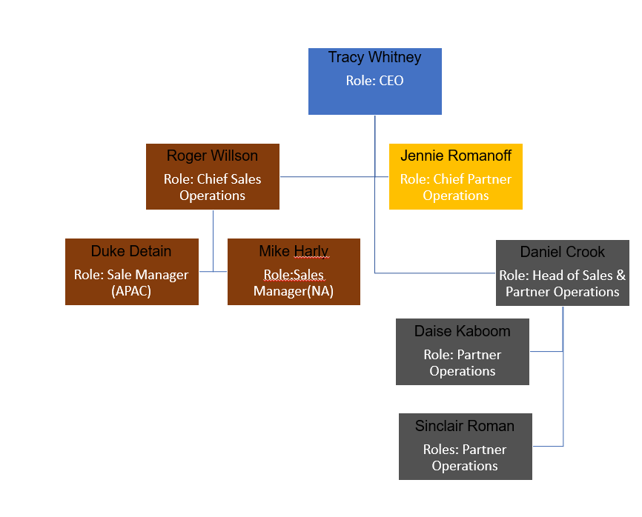
SF Admin Basics Challenge - 5
UC #2: Setup Role hierarchy as below

Slide 15
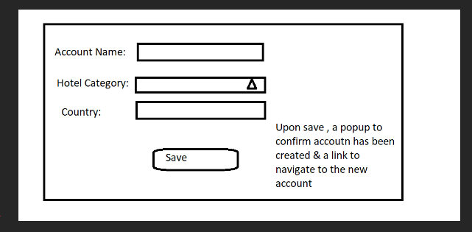
SF Admin Basics Challenge - 5
UC #3 : Ensure account (hotel partners) records are secured in such a way that only owners can see the record
UC #4: Ensure account (hotel partners) create & edit access is enabled only for Sales Team users (Roger, Duke & Mike) . Accounts can be edited by Partner Operations team (Jennie, Daniel, Daise, Sinclair) but no create access
UC#5: Ensure all accounts (hotel partners) are visible to Daniel Crook and Jennie Romanoff
UC #6: Ensure accounts (hotel partners) having Billing Country (USA, Mexico & Canada) are visible to Mike Hurly
UC #7: Create a screen flow for CEO to create hotel partner record from home as below. Ensure the screen is visible only for users having “TH: Custom – Executives” profile

Slide 16
SF Admin Basics Challenge - 8
UC #8: Update “Partner Hotels” list view to include Billing Country , account owner & created by user details
UC #9 : Create a custom field named “Traveller Contact Credit Card ” to hold card information.
Ensure the system throws an error when the field is left empty and contact type is selected as ‘Travellers Contact’’
UC #10: Enable field history for “Traveller Contact Credit Card” field to track all changes . Ensure the tracked changes are shown on contact record page
Link to upload screen shots
To be shared

Slide 17
SF Admin Basics Challenge - 6
What you need
Trailhead playground
Challenge
UC #1 : Create a custom object named “Legal Review” with the below fields
Account (Type: should have relationship with Account object)
Notes from Sales Team(Type: Text area)
Review Status(Type: picklist with values New, In-Progress, Can do business with, Legal Problems exist)
Review Comments (Type: Text Area)
UC #2 : Create the following customs fields
Account Object | Legal Review Request (Type: Check box)
Account Object | Sales Team Comments: (Type: Text area)
Contact Object | Traveller Contact Credit Card Status (Type: Picklist | Values: Valid, Invalid, Validation In-Progess)
UC #3 : Ensure the fields (Legal Review Request & Sales Team Comments) are visible only for users having profiles ‘Custom:Standard platform - Sales Team Member’ & ‘System Admin’. For other profiles, fields should be hidden
UC #4: Automate the following business process
When a new hotel partner is created in the system with ‘Legal Review Request’ selected, the system should
Automatically create a Legal Review request
Ensure data entered in “Sales Team Comments” on account record is copied to “Notes from Sales Team”
Ensure Review status is set as ‘New’

Slide 18
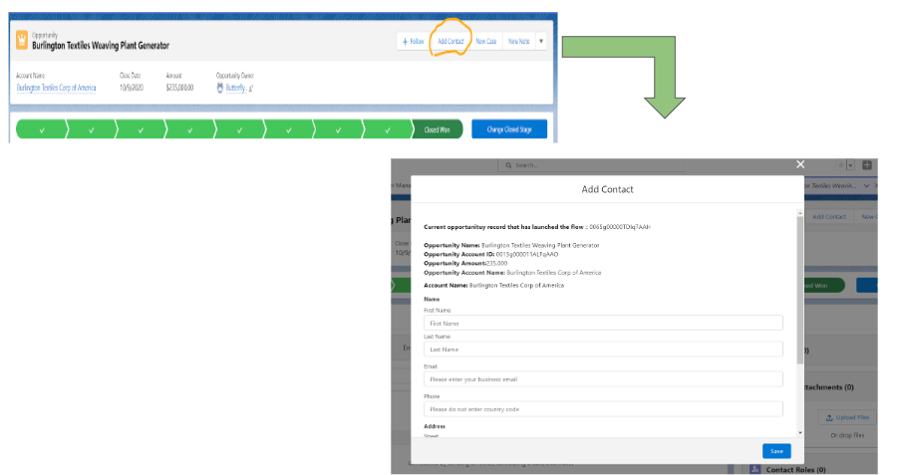
SF Admin Basics Challenge - 6
UC #5: Automate the following business process
Travel Hut team wants to see an option as ‘QUICK ACTION’ to add a “New Contact” directly from any opportunity record screen
Should have a screen with all required fields for creating a contact like last name , address, salutation etc
It should be accessible from any opportunity record page
Ensure a success msg is shown when a link to redirect after a new contact is created

Slide 19
SF Admin Basics Challenge - 6
UC #6: Automate the following business process
Sales Team in Travel Hut is looking for an easy way to view traveler contact credit cards that have been flagged as ‘Invalid’
Should have a screen with table showing the following fields
- Contact Name, Traveller Contact Credit Card, Traveller Contact Credit Card Status
It should be accessible from any account (hotel partner) record page
Should show only contacts related to the account (hotel Partner)
Link to upload screen shots
To be shared

Slide 20
SF Admin Basics Challenge - 7
What you need
Trailhead playground
Challenge
UC #1 : Create a few sample contract records and associate with accounts
UC #2 : Create a process automation to show list of contracts on account page that are due for renewal.
- Any contract with in ‘Activated’ status and ‘Contract End Date’ is less than 30 days from current date should be considered as contracts that are due for renewal
- Should display the contract Number, Start date, End date & Contract Terms(month)
UC #3: Automate the following business process
When a contract is due for renewal send an automated email to the account owner with the following details in email body
Contract Number
Start Date
End Date
Contract Terms (Month)
Ref:
Use Case: Automate Emails with Schedule-Triggered Flow (salesforce-flowsome.com)
Step By Step Guide to Creating Schedule-Triggered Flow in Salesforce (asagarwal.com)

Slide 21
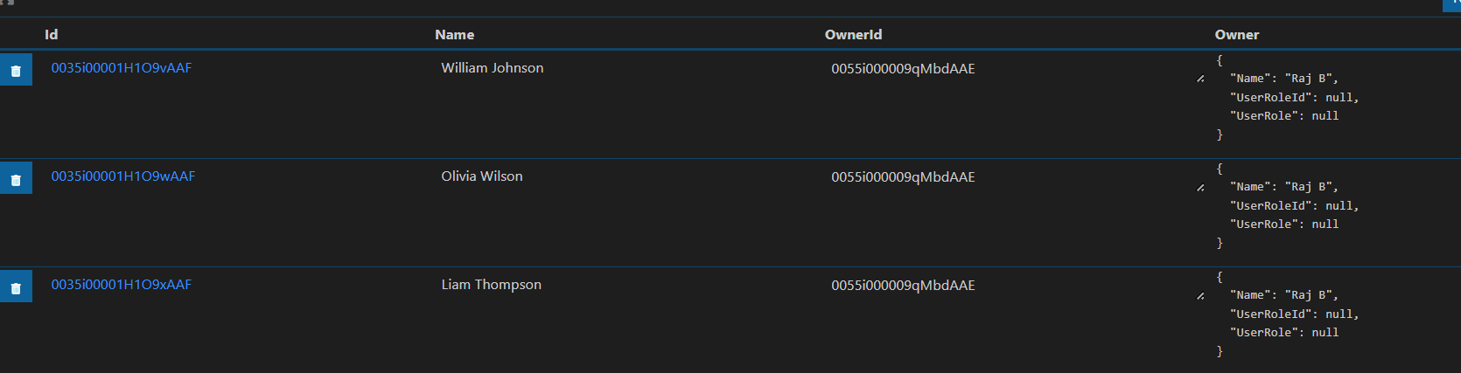
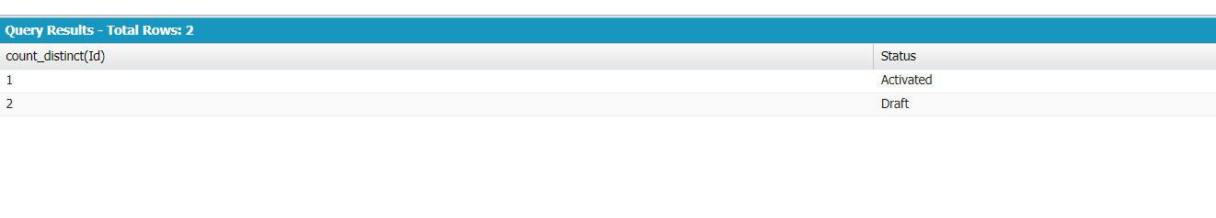
SF Admin Basics Challenge - 7
UC #4 : Create a query to show contact Id, contact Name, Contact owner Name, Contact owner’s role where account’s partner hotel flag is true
- Use either work bench, developer console or VS SQL code builder
UC #5 : Create a query to get the count of contracts by Status like below
Link to upload screen shots
To be shared

Slide 22
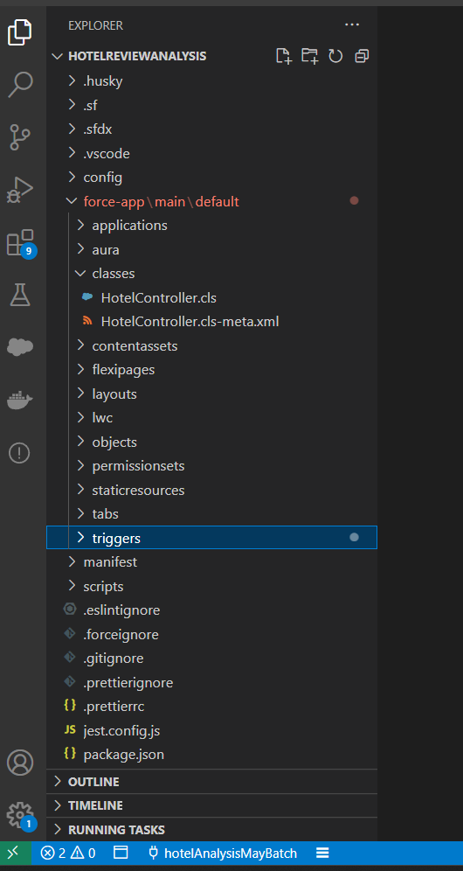
SF Admin Basics Challenge - 8
What you need
Trailhead playground
VS Code , Salesforce Extension Pack, Salesforce CLI (SFDX)
Challenge
UC #1 : Create a new SFDX project on your local machine and use VS code extension to connect to your playground org
UC #2 : Create a new apex class named ‘HelperUtilController’ in VS Code and deploy the file to your org
Create a new public method named ‘getAllPartnerHotels’
Add logic to query partner hotels from the DB and display data in Developer console log

Slide 23
SF Admin Basics Challenge - 8
UC #3: Create a new apex trigger named ‘ContractTrigger’ in VS Code. Implement the below use case using Trigger
When a user attempts to delete a contract, check if the contract is in ‘Activated’ Status.If yes, raise an error stating ‘Activated contract cannot be deleted’. Else, allow the system to delete
UC #4: Create a queue in your org as below
Queue Name: High Priority Case Management Team
Ensure the user ‘Tom Wheelie’ is added as team member
Note: Create a new user, if not already exists
User name -“Tom Wheelie”
profile: Clone “Custom:Sales Profile” and name it as ‘TH: Custom – Sales Profile’
License: Salesforce
UC #5: Create an APEX Trigger and implement the following business process
When a case with high priority is created or updated , ensure system assigns the case to “High Priority Case Management Team” queue
Link to upload screen shots
To be shared

Slide 24
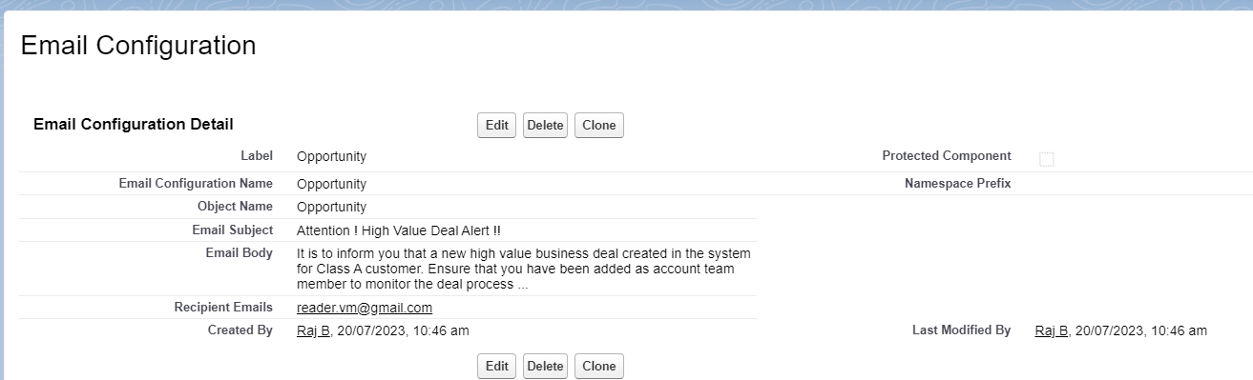
SF Admin Basics Challenge - 9
What you need
Trailhead playground
VS Code , Salesforce Extension Pack, Salesforce CLI (SFDX)
Challenge
UC #1 : Create a new Custom meta data type with a record as follows

Slide 25
SF Admin Basics Challenge - 9
UC #2 : Use existing apex class ‘HelperUtilController’ and add the below new method. Use VS Code and deploy the file to your org
Create a new public method named ‘getEmailConfig’
Make sure the method takes a string as input parameter
Based on the input parameter value, add logic to fetch data from custom meta data type created in use case#1
UC #3: Create a new apex trigger named ‘OpportunityTrigger’ in VS Code. Implement the below use case using Trigger
When an opportunity with revenue more than $10,00,000 created, the system should send an email to the recipient configured in custom meta data type
Tip: At times, Gmail or company email blocks salesforce emails. Hence, create a temp email using online service like https://10minutemail.net/ for email configuration
UC #4: : Use existing apex class ‘HelperUtilController’ and add the below new method.
Create a new public method named ‘SendEmailMessage’
Ensure the method is written with appropriate reusable logic for sending email when it is called from triggers
Link to upload screen shots
To be shared

Slide 26
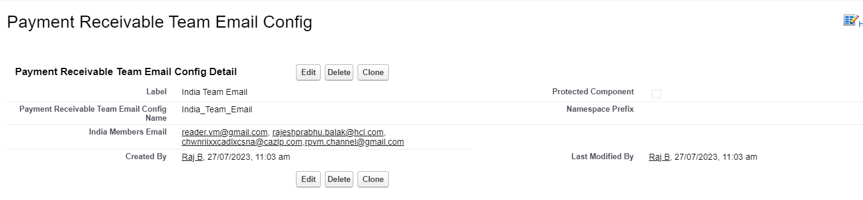
SF Dev Challenge - 10
What you need
Trailhead playground
VS Code , Salesforce Extension Pack, Salesforce CLI (SFDX)
Challenge
UC #1 : Create a new Custom meta data type with a record as follows

Slide 27
SF Dev Challenge - 10
UC #2 : Ensure ‘PaymentDueDateUtil’ class is further modified and include logic that will send email to the recipients configured in CMBDT
You may create payment due date custom field on account object
You may reuse send email method created in last week code challenge
UC #3: Refer: AccountTrigger.txt . Find issues in the code and ensure all APEX best practices are followed
UC #4: : Refer: PriceCalculator.txt. Ensure a test class is created to test calculateTotalPrice() method
UC #5: : Create a new test class named ‘LoadDataSample’.
Create a new test method named ‘SampleDataForTest’
Ensure it is annotated with @testsetup
Ensure you are using Test.LoadData() to load test accounts and related contacts (minimum 3 accounts and for each account 2 contacts)
Use System.debug to show test accounts and contacts created
Reference Links:
https://www.jitendrazaa.com/blog/salesforce/using-test-loaddata-to-import-records-with-relationship/
https://www.mhamzas.com/blog/2020/09/22/test-class-data-from-static-resource/
Link to upload screen shots
To be shared

Slide 28
SF Dev Challenge - 11
What you need
Trailhead playground
VS Code , Salesforce Extension Pack, Salesforce CLI (SFDX)
Challenge
UC #1 : Create a new Custom meta data type with a record as follows

Slide 29
SF Dev Challenge - 11
UC #2 : Ensure ‘PaymentDueDateUtil’ class is further modified and include logic that
will send email to the recipients configured in CMBDT
You may create payment due date custom field on account object
You may reuse send email method created in last week code challenge
UC #3 : Ensure ‘PaymentDueDateUtil’ class is further extended using Batchable interface to process records in in batches so it can handle bulk records as well
UC #4 : Create a new class named ‘PaymentDueDateReminder’ class include logic to make the code schedulable so that it runs everyday at 9 P.M
Call PaymentDueDateUtil batch apex class from PaymentDueDateReminder schedulable class
Reference Links:
https://www.testim.io/blog/how-to-call-batch-apex-salesforce/#:~:text=First%2C%20you%20can%20call%20the,job%20in%20a%20few%20minutes.&text=Second%2C%20you%20can%20schedule%20it,implements%20both%20Batchable%20and%20Schedulable).

Slide 30
SF Dev Challenge - 11
UC #5 : : Create 2 new users
User 1 name -“Benny Cook”
User 2 name -“Thomas Cook”
profile: “Custom:Standard platform user – Audit Team”
Role: “Audit Team”
License: Salesforce Platform
UC #6: Introduce a new relationship field on account record named ‘Audit Team Member’. Set Account object OWD as private.
UC #7: When an audit member is mapped to a particular account record, ensure the record is shared with the audit team member. Ensure audit member has only read access. Also, when audit member is changed, record sharing should automatically be stopped.
For e:g:
E:g Scenario 1: Say for Hotel Bliss Resort, audit team member is ‘Benny Cook’. The system should immediately share the record to only ‘Benny Cook’ with read access . There should be no access to ‘Thomas Cook’.
E:g Scenario 2: Say for Hotel Bliss Resort, audit team member is replaced from ‘Benny Cook’ to ‘Thomas Cook’. The system should immediately share the record to only ‘Thomas Cook’ with read access and revoke ‘Benny Cook’ existing access
https://techdicer.com/sharing-records-by-apex-in-salesforce/
https://www.jitendrazaa.com/blog/salesforce/apex-based-sharing-in-salesforce/
Link to upload screen shots
To be shared

